Slide 1

Department of Information and Communication Technology
Mawlana Bhashani Science and Technology University
Santosh,Tangail
Course Title:EDGE ICT - Python -DJango
Presentation Title:Personal Poetry Platform
– A web-based platform for showcasing and managing personal poems
Presented to
Dr Ziaur Rahman
Associate professor
Dept.of ICT,MBSTU
Presented by
Mst.Mostary Khatun
ID-IT20036
Dept.of ICT,MBSTU

Slide 2
Table of content
Introduction
Key Features
Technologies Used
System Architecture
Project Structure
Key Files
Demonstration & screenshort
Challenges Faced
Future Enhancements
Conclusion

Slide 3

Introduction
Objective:
Created a platform where users can share their poems.
Provide features like user authentication, wishlist functionality, and comments.
Why This Project?
Combines creativity with technology.
Addresses the need for a personal space to share poems.

Slide 4
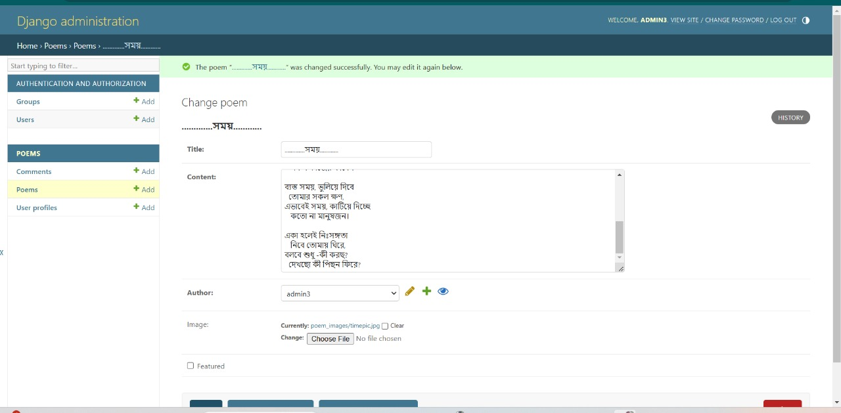
Key Features
User Authentication:
Registration, Login, Logout.
Poem Management:
Add, view, and manage poems.
Comments:
Engage with others by commenting on poems.
Wishlist:
Save favorite poems for future reference.
Admin Panel:
Manage users and content.

Slide 5
Technologies Used
1
Front-End: HTML, CSS
2
Backend: Django
3
Database: SQLite
4
Virtual Environment for dependency management
5
GitHub for version control

Slide 6
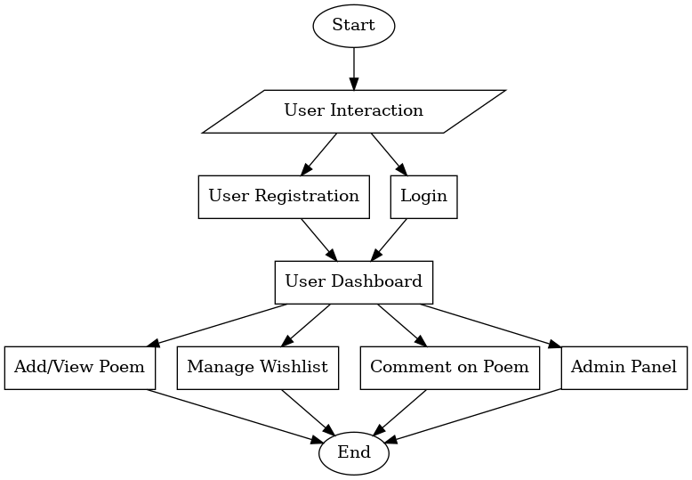
System Architecture
User Interface:HTML Templates (Bootstrap integrated for responsiveness).
Business Logic:Django Views handle core functionalities.
Data Storage:SQLite database stores poems, users, and wishlist items.
Static Files:CSS for styling, collected in a static directory.

Slide 7
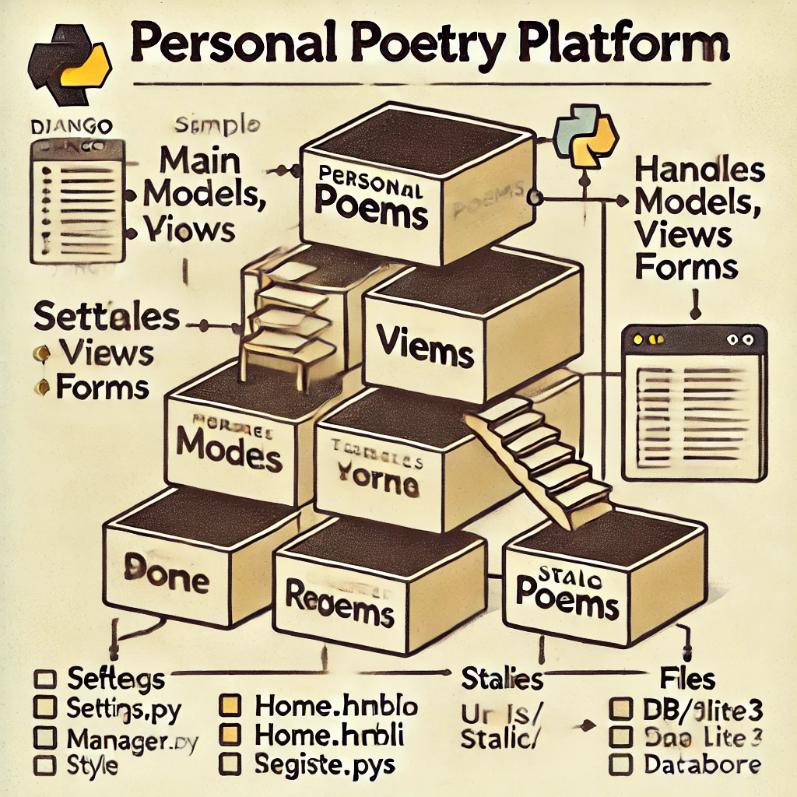
Project Structure
Main Folders:
PersonalPoetryPlt/: Project settings and configurations.
Poem/: App for managing poems, models, and views.
Templates/: HTML templates.
Static/: CSS and other static resources.
Database:SQLite(db.sqlite3)
Virtual Environment: venu/

Slide 8
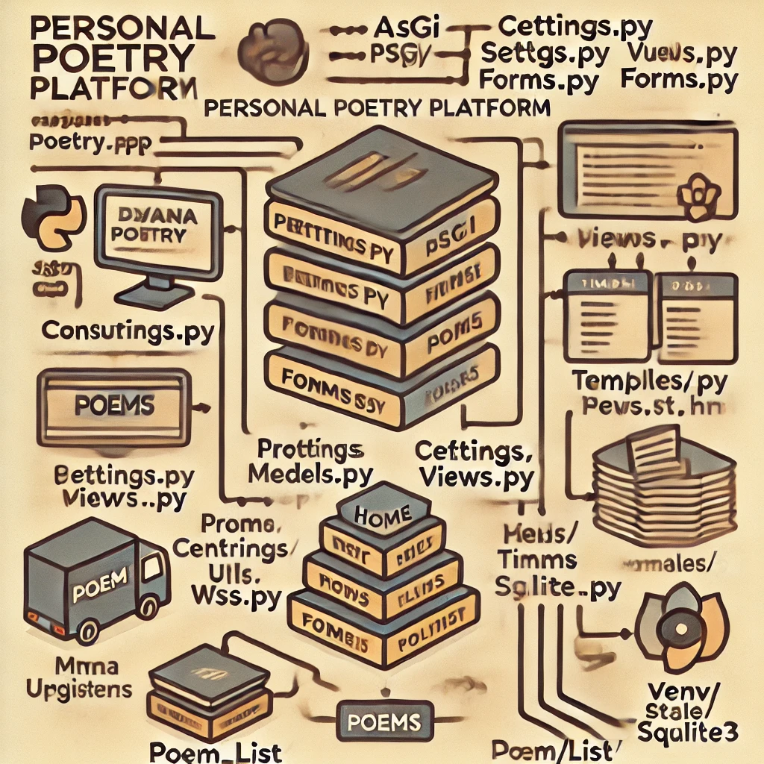
Key Files
Settings.py:Configures the Django project.
Urls.py:URL routing for the project.
Views.py:Handles user interactions and logic.
Models.py:Database schema for poems, comments, and wishlist.
Templates:HTML files for each page (eg.home.html,register.html)

Slide 9
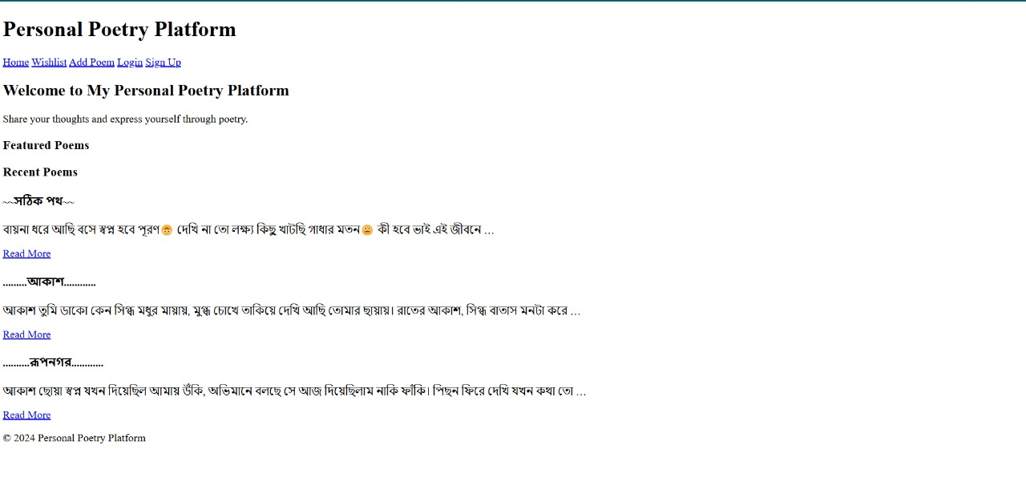
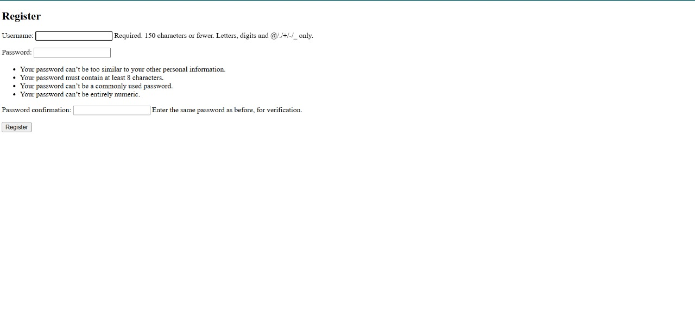
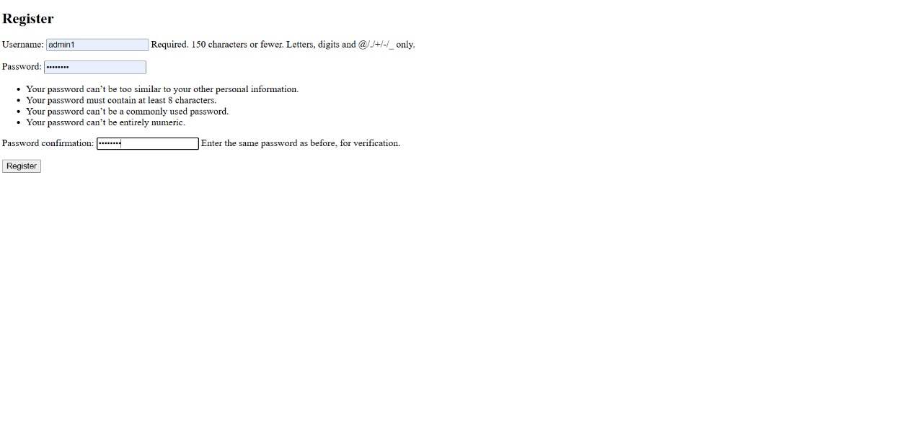
Demonstration & screenshort
Home Page:
Showcases featured and recent poems.
User Registration/Login:
Register or log in to access features.
Poem Management:
Add, edit, view, and delete poems.
Wishlist:
Save poems and manage wishlist.
Comment Section:
Engage with other users through comments.

Slide 10
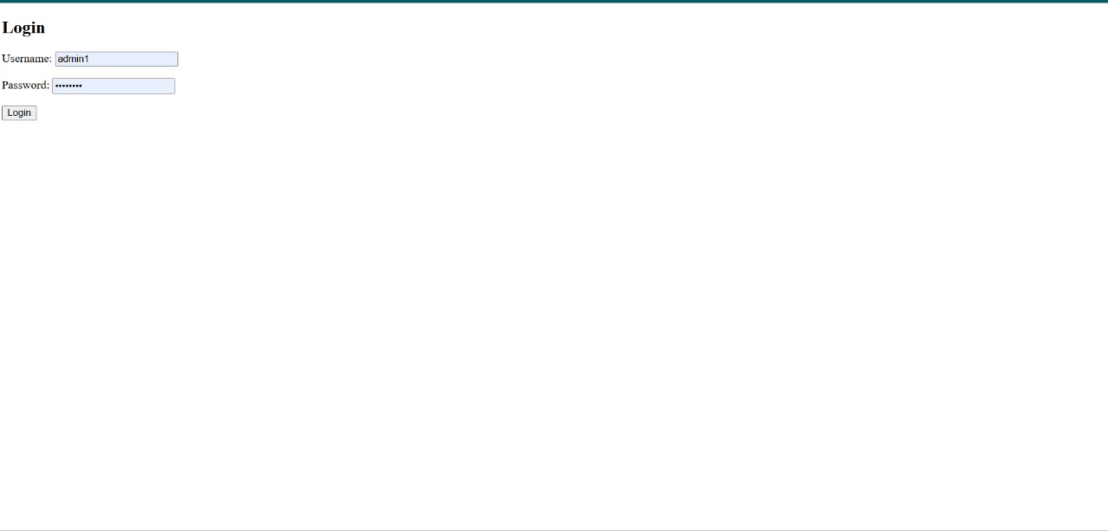
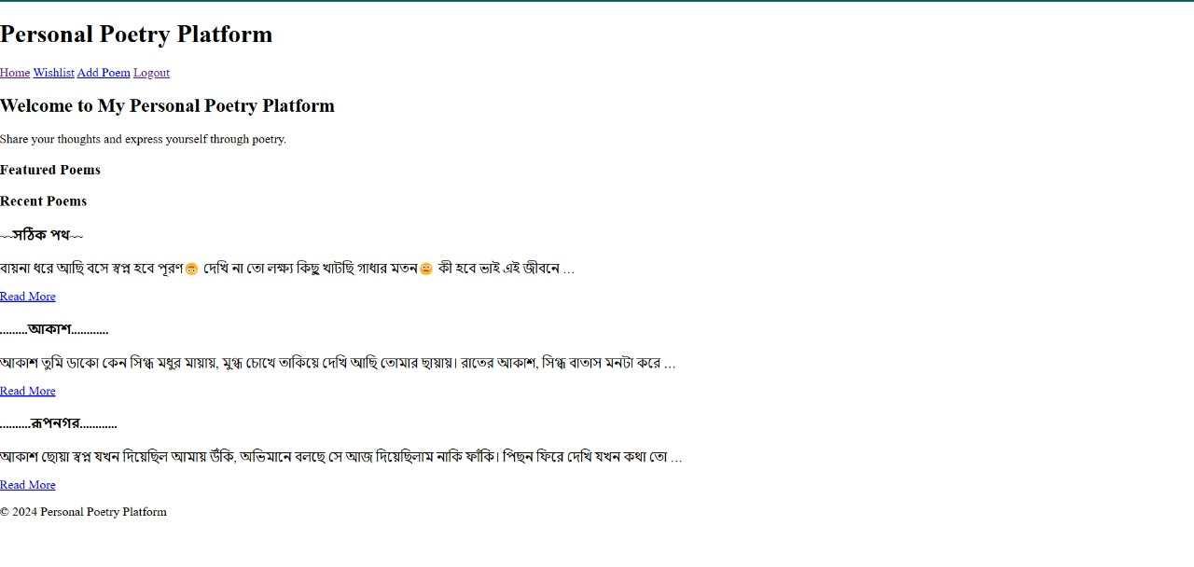
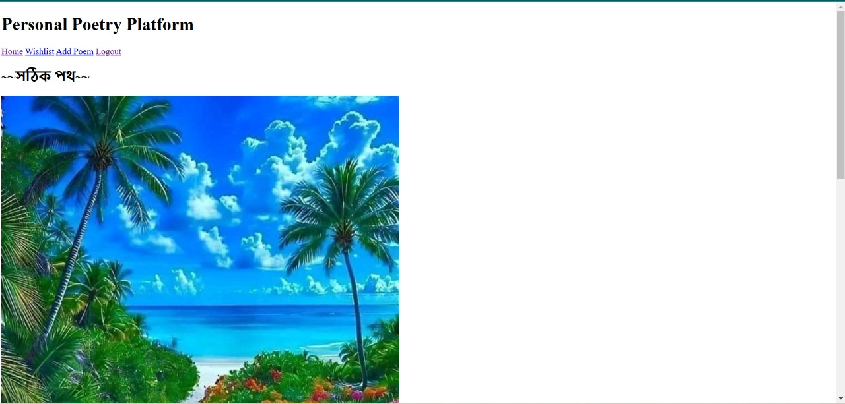
Demonstration & screenshort(con..)
Home Page:
Showcases featured and recent poems.
User Registration/Login:
Register or log in to access features.
Poem Management:
Add, edit, view, and delete poems.
Wishlist:
Save poems and manage wishlist.
Comment Section:
Engage with other users through comments.

Slide 11
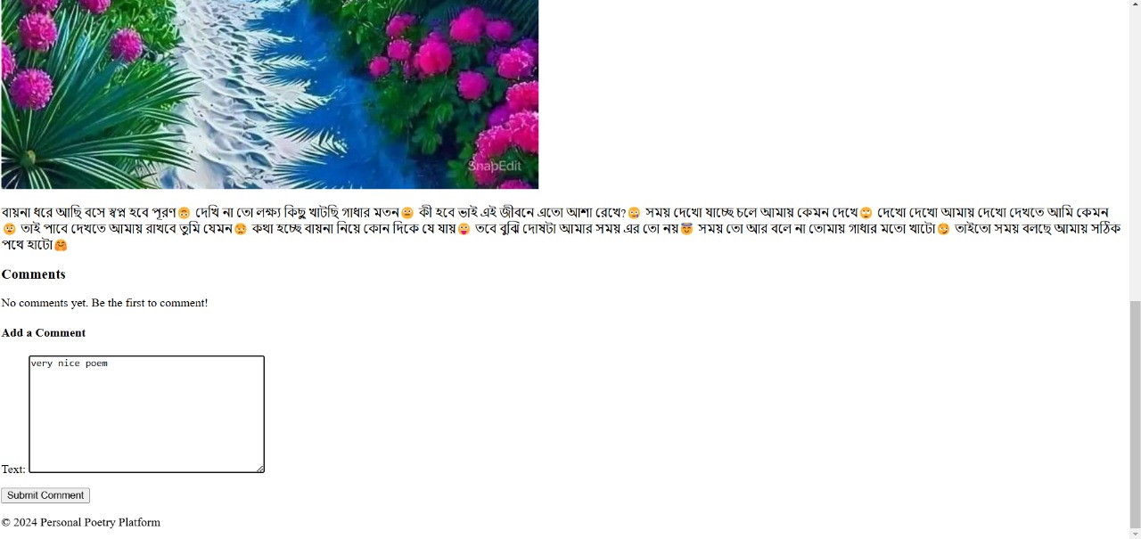
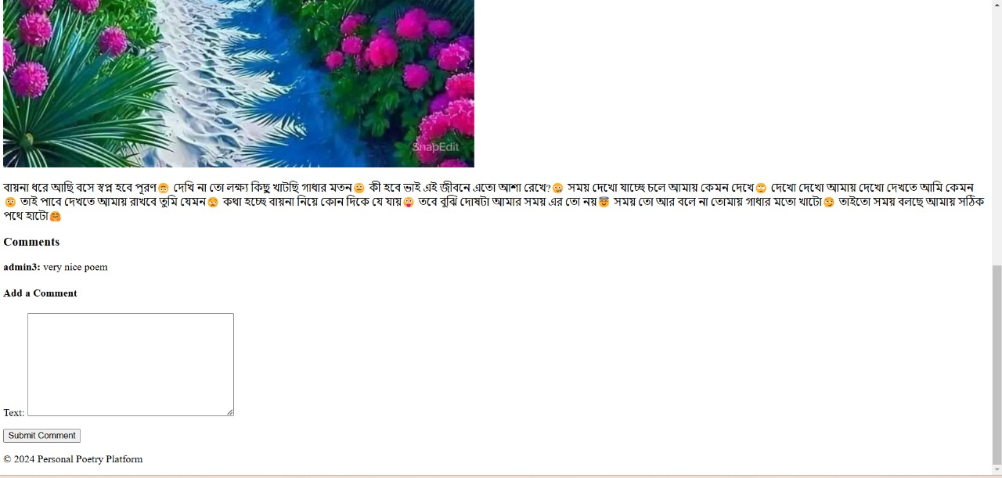
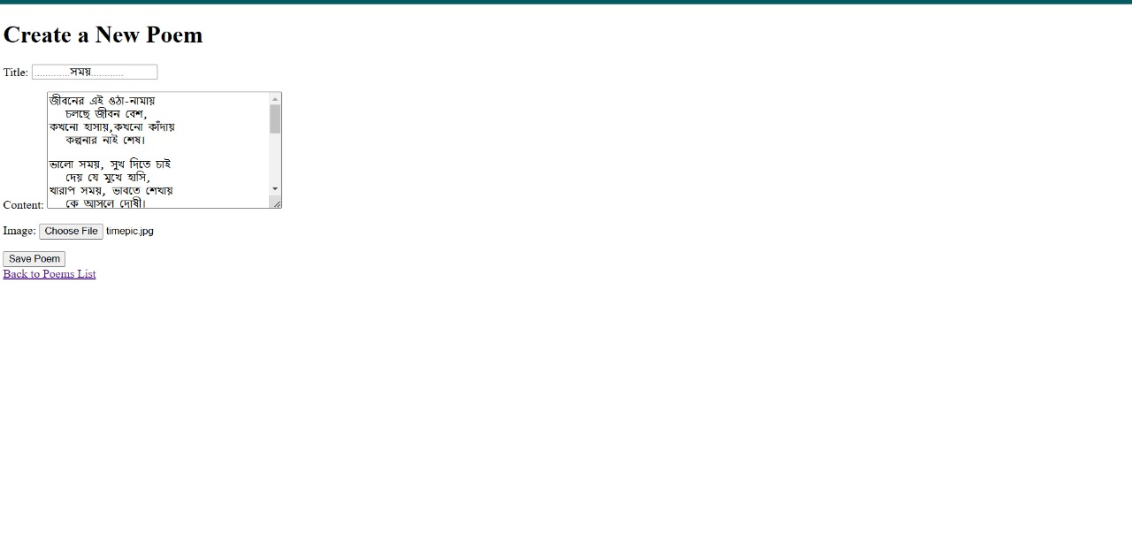
Demonstration & screenshort(con..)
Home Page:
Showcases featured and recent poems.
User Registration/Login:
Register or log in to access features.
Poem Management:
Add, edit, view, and delete poems.
Wishlist:
Save poems and manage wishlist.
Comment Section:
Engage with other users through comments.

Slide 12
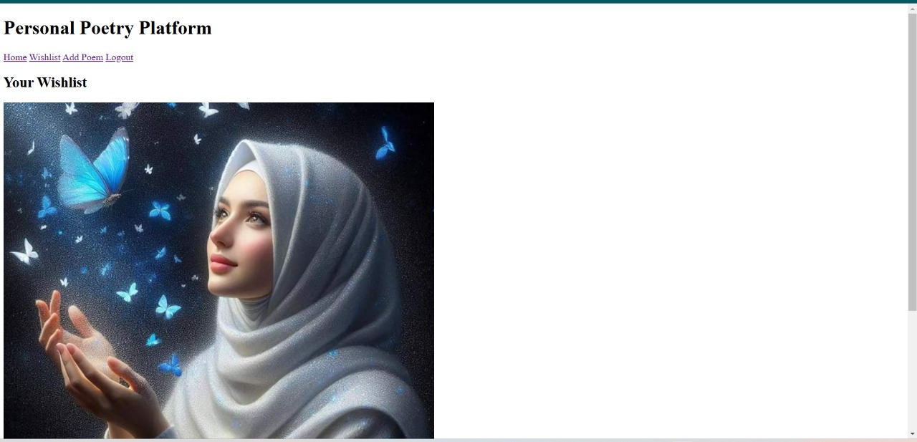
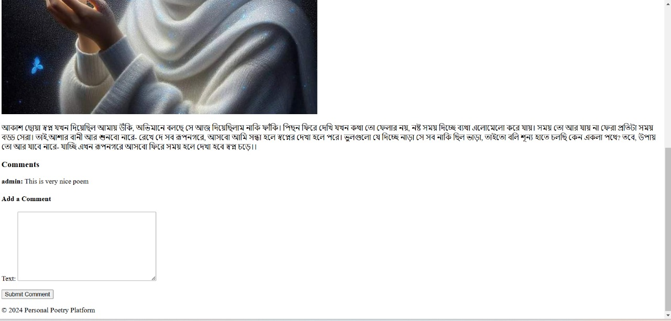
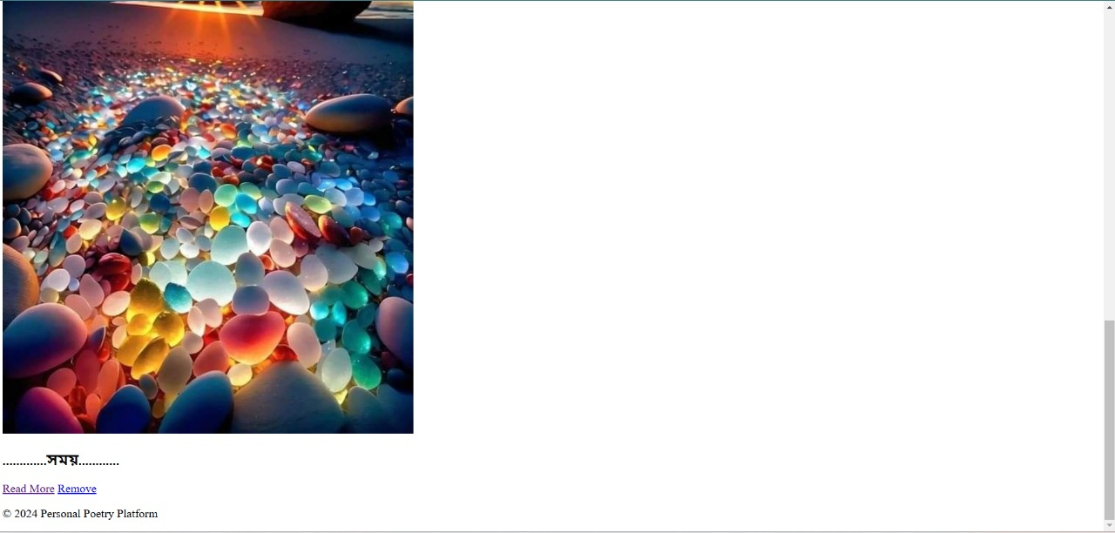
Demonstration & screenshort(con..)
Home Page:
Showcases featured and recent poems.
User Registration/Login:
Register or log in to access features.
Poem Management:
Add, edit, view, and delete poems.
Wishlist:
Save poems and manage wishlist.
Comment Section:
Engage with other users through comments.

Slide 13
Challenges Faced
Integrating user authentication.
Handling static files and media uploads.
Designing a clean and intuitive UI.
Managing merge conflicts during version control.

Slide 14
Future Enhancements
Advanced Search:
Allow searching poems by title, author, or keywords.
Social Sharing:
Share poems on social media platforms.
Mobile App:
Develop a mobile-friendly version.
Enhanced Analytics:
Provide analytics for poem views and user activity.

Slide 15
Conclusion
Key Takeaways:
Learned Django development and integration.
Built a platform combining creativity and technology.
Provided features for both authors and readers.
Acknowledgment:
Thank mentors, peers, and resources for guidance.
GitHub Link: https://github.com/MostaryKhatun/project

Slide 16
THANK YOU

